Slide 1


Online Access to Archival Tissue Samples -
The Harvard Virtual Specimen Locator (VSL) Project
Bruce Beckwith, MD
Department of Pathology
Beth Israel Deaconess Medical Center
Harvard Medical School
Boston, Massachusetts

Slide 2
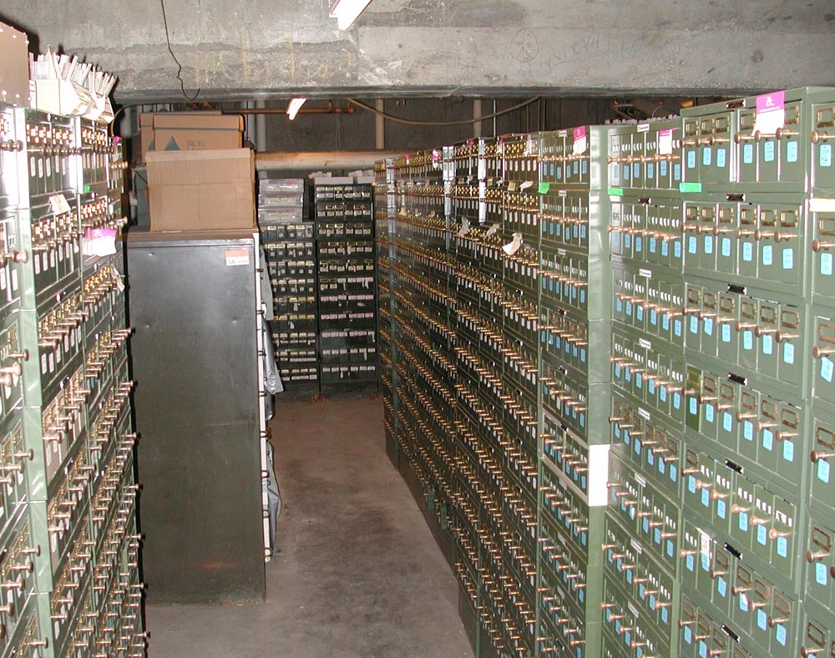
The Challenge
Notes:
Paraffin embedded tissue is increasingly useful in biomedical research as molecular methods improve
There are millions of paraffin embedded human tissue samples in storage in pathology departments across the country
These post-diagnostic excess tissues are well-characterized by pathologist examination
The pathology reports are available electronically in laboratory information systems

Slide 3
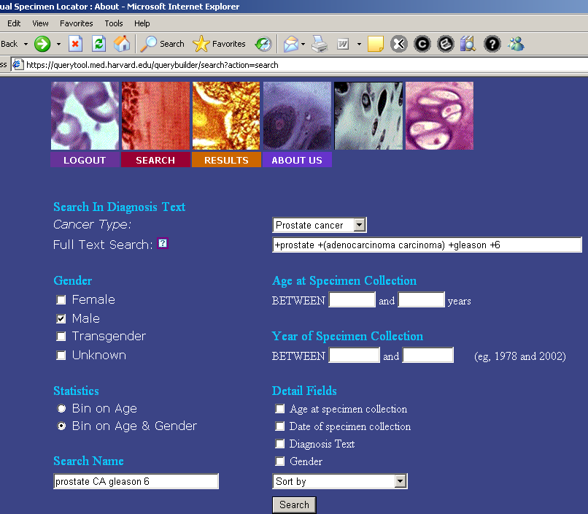
A Solution
Notes:
Paraffin embedded tissue is increasingly useful in biomedical research as molecular methods improve
There are millions of paraffin embedded human tissue samples in storage in pathology departments across the country
These post-diagnostic excess tissues are well-characterized by pathologist examination
The pathology reports are available electronically in laboratory information systems

Slide 4
Tissue Resources at Harvard
>50 tissue repositories at HMS affiliated institutions
Includes frozen and paraffin embedded tissue
Associated clinical information varies
No standard information storage
No easy way for investigators to learn about or search these tissue resources

Slide 5
Locating Tissue – Option 1
Have idea
Figure out where tissue might be
Locate interested colleague in tissue repository
Request IRB permission for record review
Ask colleague to search for cases
Review results and identify cases
Apply to IRB for permission to retrieve cases
Repeat steps 2-7 for each tissue source
Obtain tissue and perform study

Slide 6
Locating Tissue – Option 2
Have idea
Search online virtual repository
Mark individual specimens for retrieval
Contact representatives of repository
Apply to IRB for permission to retrieve cases
Repeat steps 4-5 as needed
Obtain tissue and perform study

Slide 7
Background & Overview

Slide 8
Shared Pathology
Informatics Network (SPIN)
NCI initiative
5 year demonstration project
Funded 2 consortia
  Harvard/UCLA
  Indiana/Pittsburgh
Built functioning network
Proof of concept tissue studies ongoing

Slide 9
SPIN Challenges
Integrate heterogeneous data sources
Allow local control of information
Respect patient privacy
Comply with federal regulations
  HIPAA, common rule
Respect limitations on tissue use
Easy to use search tool
Scalable architecture
Good performance
Notes:
Pathology reports exist in multiple formats depending upon the LIS and local preferences

Slide 10
Overview of SPIN
User
(Web browser)
SPIN Network
HTTP
Query
Tool
(Web server)

Slide 11
Peer to Peer Network
Established design for information sharing (Napster, Gnutella)
No central database
Each participant manages their own “node” locally
Nodes may run different software
Scales up well
Notes:
Each site can choose what to load into node
Also can choose to participate in one or more networks
Can withdraw participation simply by taking node offline

Slide 12
SPIN Network
User
Pitt
Node
HTTP
Indiana
Node
Query
Tool
MGH
Node
UCLA
Node
BWH
Node
BIDMC
Node
CHMC
Node
Notes:
Node software is not required to be the same for all nodes
Indiana runs their own software
What is standardized are the required data elements for each record (very few)
And the message formats to send queries and return results
The network will support multiple different query tools as well

Slide 13
SPIN Network
Harvard: 850,000
UCLA: 1,000,000
Pittsburgh: 100,000
Indiana: 500,000
Total: > 2,000,000
7 Nodes
Search takes 30-90 seconds

Slide 14
Virtual Specimen Locator (VSL)
Unify access to HMS tissue repositories
Extend SPIN tools to create production network
Cross-institution project
Dana Farber Harvard Cancer Center funded
A DFHCC core facility

Slide 15
VSL Goals
Build on the SPIN idea and tools
Wide participation among tissue banks
Build a common set of business rules
Protect patient privacy
Respect limitations on tissue use
Extend clinical information that may be searched

Slide 16
VSL Challenges
Obtaining cooperation of various institutions
Coordinating the IRB’s of the different HIPAA covered entities
Signing up tissue repositories

Slide 17
Overview of VSL
User
(Web browser)
VSL Network
HTTPS
Query
Tool
(Web server)
Notes:
Overview looks exactly the same as SPIN, as it should, since we just extended their tools

Slide 18
VSL Network
User
HTTPS
BWH
Node
Peer
Node
Peer
Node
Peer
Node
Query
Tool
HMS
Node
Peer
Node
CHMC
Node
MGH
Node
BIDMC
Node

Slide 19
VSL Network
BIDMC 318,883
BWH 428,226
MGH 100,777
CHMC 23,205
Total: > 850,000
Live June 2005

Slide 20
IRB Oversight of VSL
User
Pathology
Node
Tools
MGH
Node
UPDATE
Clinical
HTTPS
BWH
Node
Node
Tools
Pathology
UPDATE
Query
Tool
Clinical
HMS
Node
CHMC
Node
Node
Tools
Pathology
UPDATE
Clinical
BIDMC
Node
Node
Tools
Pathology
UPDATE
Clinical
Notes:
Entire network: HMS IRB
Each node: IRB of institution housing the repository
Each study: IRB of PI and IRB overseeing each repository
HMS deals with overall structure and function of the network, rules for joining the network, etc.
Local IRB deal with procedures for each relevant node, privacy, deidentification, consent, waiver of authorization, waiver of consent, etc.
Investigator from A needs tissue from B, apply to both IRBs.

Slide 21
Populating a Node

Slide 22
Information Pipeline
Extract pathology reports from LIS
Convert from the local format into the SPIN XML format
Remove identifying information
Automatically code important medical concepts
Load into local “node” database

Slide 23
Local view of institution
Pathology
SPIN
Node
Network
Node
Tools
Clinical
UPDATE
MPI
Codebook of
repository
Institutional
Systems
Institutional
Firewall
Internal
Threshold

Slide 24
Loading a Node
Case/specimen record processing is done on a machine separate from node
Unique random code is generated for each case
Codebook is separate from node and is not directly linked
No identifying information resides in the node

Slide 25
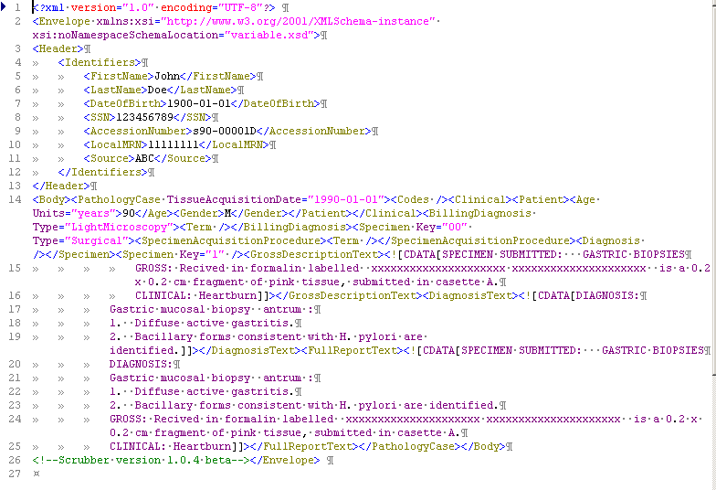
Example XML
Notes:
The identifiers are easy to interpret elements. These elements are not loaded into any nodes!
Note the duplication of the text fields

Slide 26
Deidentification

Slide 27
Deidentification
Pathology reports always contain identifiers
Header information is trivial to remove since it resides in well defined fields
Identifying information embedded in text of pathology reports is difficult to completely remove
Notes:
Critical step in the pipeline

Slide 28
HIPAA and Deidentification
18 categories of information defined
If all of this information is removed, then it is no longer considered Protected Health Information (PHI)
Certain non-identifying information may be left in
  Ages (<90 years)
  Locations (state, country)
Notes:
All individually identifying information must be removed AND there must be NO REASONABLE BASIS to believe that the person could be identified from the remaining information

Slide 29
HIPAA Identifiers
Certificate/license numbers
Vehicle identifiers
Device identification numbers
WEB URL's
Internet IP address
Biometric identifiers (fingerprint, voice prints, retina scan, etc)
Full face photographs or comparable images
Any other unique number, characteristic or code
Names
ALL geographic subdivisions smaller than the state
All elements of dates smaller than a year
Ages over 89
Phone/Fax numbers
E-mail addresses
SS numbers
Medical record number
Health plan beneficiary number
Any other account numbers

Slide 30
HMS Scrubber
An open source software tool for removing direct identifiers from text of pathology reports
Modular design which is easy to modify
Multiple development cycles
Final testing on 1800 cases (600 each from BIDMC, MGH and BWH)
Notes:
Designed our own scrubber since no other ones available for use
Open Source – freely usable by anyone without licensing fees
Tuned for use on pathology reports

Slide 31
Scrubber Design
Remove identifiers specified in the header (name, mrn, accession number, etc.)
Search for information based on predictable patterns
  Dr. Xxxx
  Mrs. Yyyy
  Nn/nn/nnnn
  Dates, accession numbers
Use a list of prohibited words or phrases
  Names, locations, etc

Slide 32
Scrubbing Challenges
Accession numbers are problematic due to variety of formats in use
Misspellings hard to correct, but easy for reader to interpret
Some institutions routinely dictate personal identifiers into the text of reports, especially the gross descriptions
Scrubber needs to be customized to particular institution

Slide 33
Scrubber Performance
 | Dept. A | Dept. B | Dept. C | Total
Reports | 600 | 600 | 600 | 1800
Reports with any identifier | 415 | 239 | 600 | 1254
Unique identifiers | 1079 | 338 | 2082 | 3499
Unique identifiers per report | 1.8 | 0.6 | 3.5 | 1.9
BMC Med Inform Decis Mak 2006 6:12
Notes:
OVERSCRUBBING: Abbreviations CD20, L4-5, HMB-45
Words that are also person or place names: Brown, white, tan, toto
UNDERSCRUBBING: Misspelled names, accession numbers, ages

Slide 34
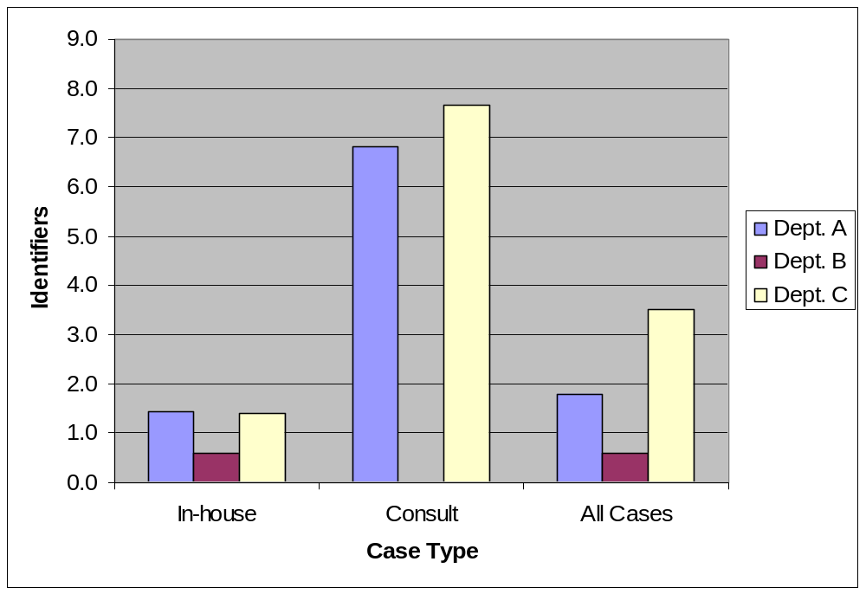
Distribution of Identifiers

Slide 35
Scrubber Performance
 | Dept. A | Dept. B | Dept. C | Total
Reports | 600 | 600 | 600 | 1800
Reports with any identifier | 415 | 239 | 600 | 1254
Unique identifiers | 1079 | 338 | 2082 | 3499
Unique identifiers per report | 1.8 | 0.6 | 3.5 | 1.9
Unique identifiers removed | 1057 | 320 | 2062 | 3439
Unique identifiers remaining, total | 22 | 18 | 20 | 60
Unique HIPAA identifiers remaining | 11 | 1 | 7 | 19
% Unique identifiers removed | 98.0% | 94.7% | 99.0% | 98.3%
BMC Med Inform Decis Mak 2006 6:12
Notes:
OVERSCRUBBING: Abbreviations CD20, L4-5, HMB-45
Words that are also person or place names: Brown, white, tan, toto
UNDERSCRUBBING: Misspelled names, accession numbers, ages

Slide 36
Identifier | Identifier Type | In-house Cases | Consult Cases | Total
Accession number | HIPAA | 0 | 10 | 10
Pt name misspelled | HIPAA | 5 | 2 | 7
Pt name correctly spelled | HIPAA | 0 | 0 | 0
Medical record number | HIPAA | 1 | 0 | 1
Date | HIPAA | 1 | 0 | 1
HIPAA subtotal |  | 7 | 12 | 19
Institution address, partial | Non-HIPAA | 0 | 17 | 17
Age <90 | Non-HIPAA | 16 | 0 | 16
Health care organization name | Non-HIPAA | 0 | 6 | 6
Doctor name | Non-HIPAA | 1 | 1 | 2
Non-HIPAA subtotal |  | 17 | 24 | 41
Grand total | HIPAA and Non-HIPAA | 24 | 36 | 60
BMC Med Inform Decis Mak 2006 6:12
Notes:
>99% of HIPAA identifiers removed
Performance varied by institution
Style differences important
Consult cases the most problematic
Need to continually validate to catch changes in style
This scrubber may be easily modified to handle other types of reports

Slide 37
Scrubber Summary
>99% of HIPAA identifiers removed
Performance varied by institution
Style differences important
Consult cases the most problematic
Need to continually validate to catch changes in style
This scrubber may be easily modified to handle other types of reports

Slide 38
Autocoding

Slide 39
Why Code Information?
Most surgical pathology data resides in unstructured text
Pathologists don’t always use the same words
Using a controlled vocabulary reduces variation
What about cancer synoptics?
  Relatively recent addition
  This information is usually stored as free text
  Advantage is standardized phrasing
Notes:
Problem of data heterogeneity
Synoptics not truly separate fields of information, unlike chemistry panel results
Standardized nomenclatures/vocabularies are available
SNOMED is the richest one for pathology concepts
UMLS is a compilation of multiple different vocabularies including SNOMED

Slide 40
Autocoding Challenges
Synonyms
Eponyms
Abbreviations
Negated concepts
  “no evidence of malignancy”
  “stains negative for AFB, fungi, and bacteria”
Level of diagnostic certainty also problematic
  “consistent with malignancy”
  “suggestive of, but not diagnostic for carcinoma”
Notes:
Coding is definitely helpful, but too time consuming for most people to do.
Also manual coding has many variation, as well.
For a project like VSL, automated coding is the only way to get coding. However, it is a
Truly hard problem since doing it well requires understanding meaning of text

Slide 41
Code Searching
Pros
  Often much faster search speeds
  If search or coding tools handle synonyms well,
  may improve results
  Some coding systems that are hierarchical
  (e.g. arm includes wrist, hand, fingers…)
Cons
  Many investigators have little familiarity with codes
  May have to choose between multiple similar but distinct codes
  Reports must be coded in the same system
Notes:
The SPIN system allows searching by code or text
VSL only allows searching by text right now

Slide 42
Text Searching
Pros
  More intuitive and familiar
  May provide higher precision with exact phrase matching
  May allow for better results if used by someone with good knowledge of pathology terms and reporting conventions
Cons
  May require knowledge of pathology terms and reporting conventions for reasonable results
  Harder to account for synonyms
  Misspellings may be more problematic
Notes:
(autocoder may recognize common misspellings)
Conclude with SPIN using both coding and text and VSL only using text

Slide 43
Using the Virtual Specimen Locator

Slide 44
Access to VSL
Website is available by Internet (secure)
All users must login using Harvard eCommons username and password
Basic access allows searching with return of statistical data only

Slide 45
Investigator Level Access
Must apply for this level
Requires human subjects training
Sign usage agreement
Allows access to deidentified diagnosis text at the individual case level
Allows marking of cases to request tissue
Notes:
Account is manually upgraded

Slide 46
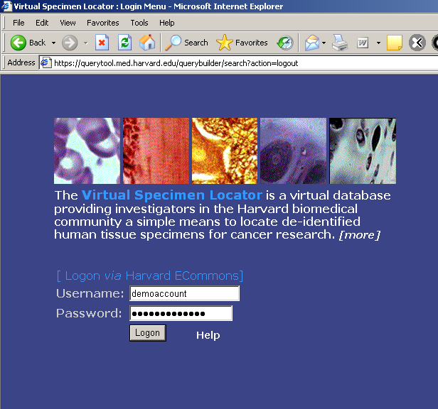

Slide 47
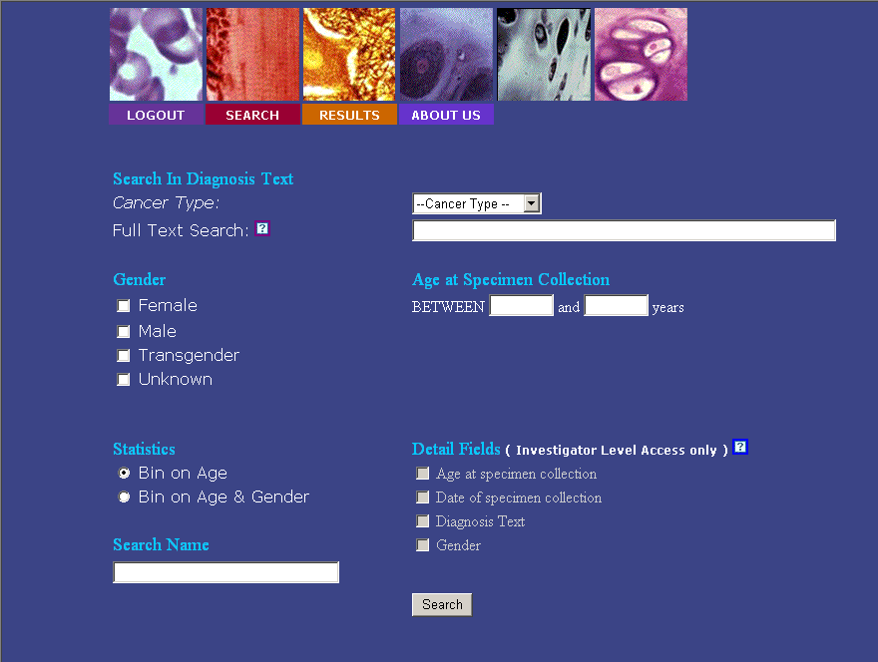

Slide 48
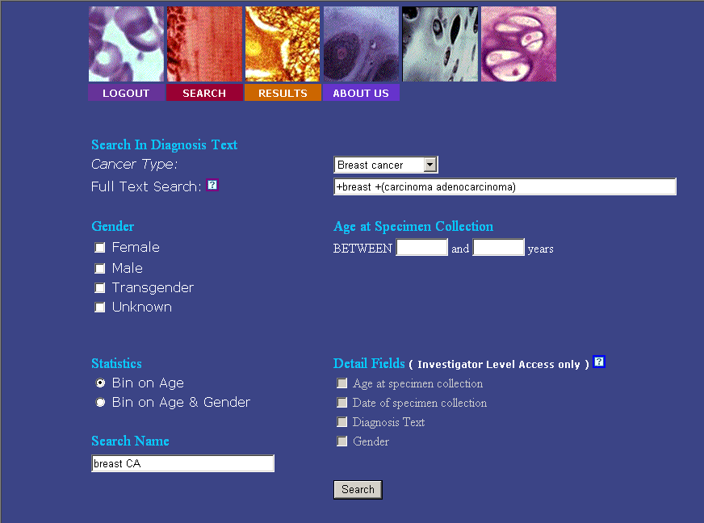

Slide 49
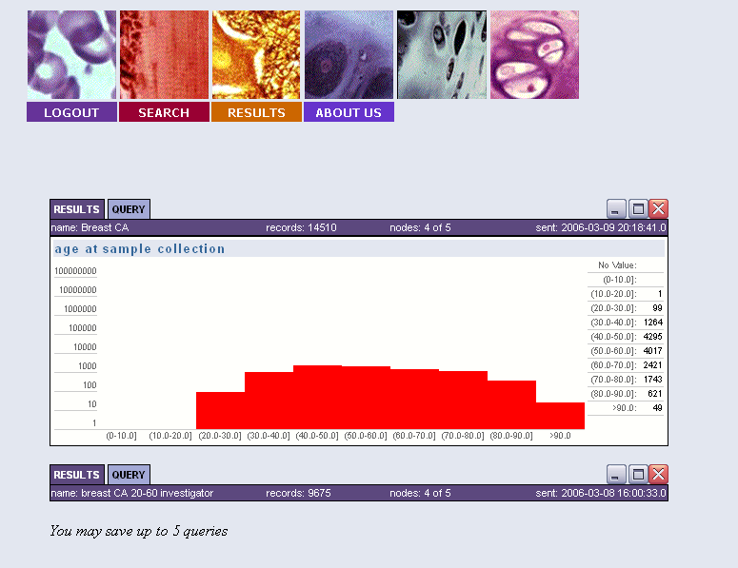

Slide 50


Slide 51
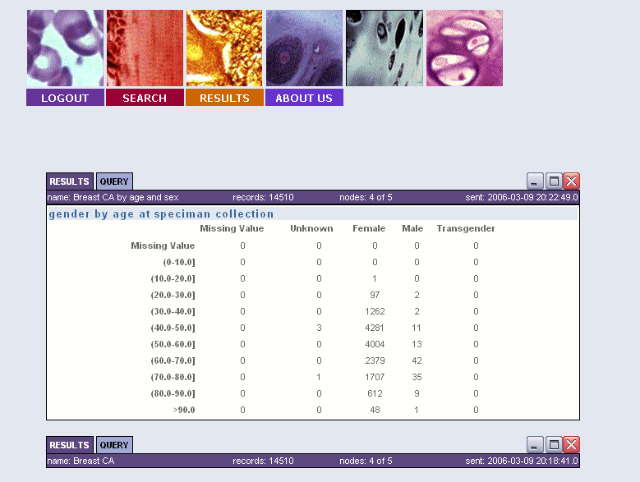

Slide 53
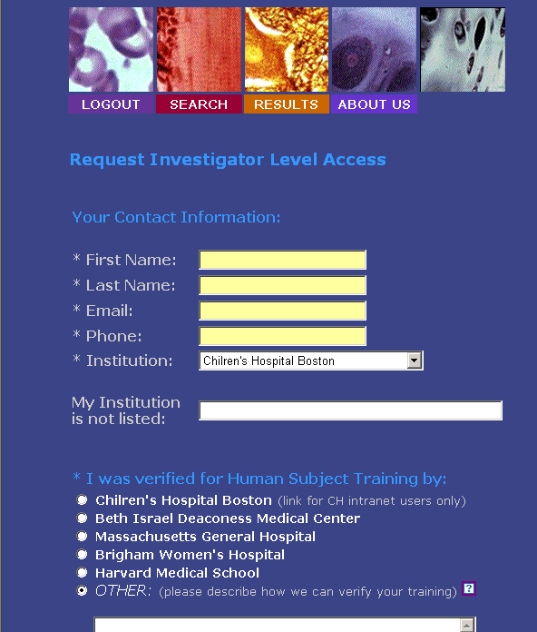
Investigator Level

Slide 54
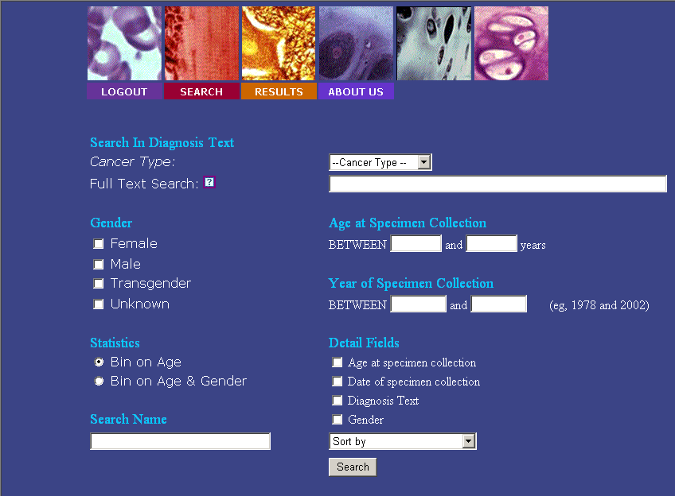

Slide 55
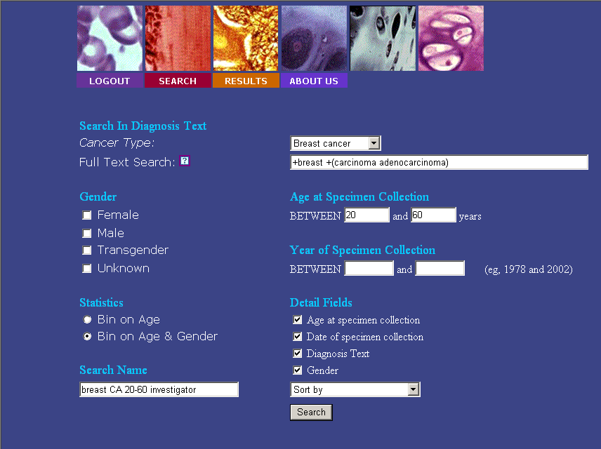

Slide 56
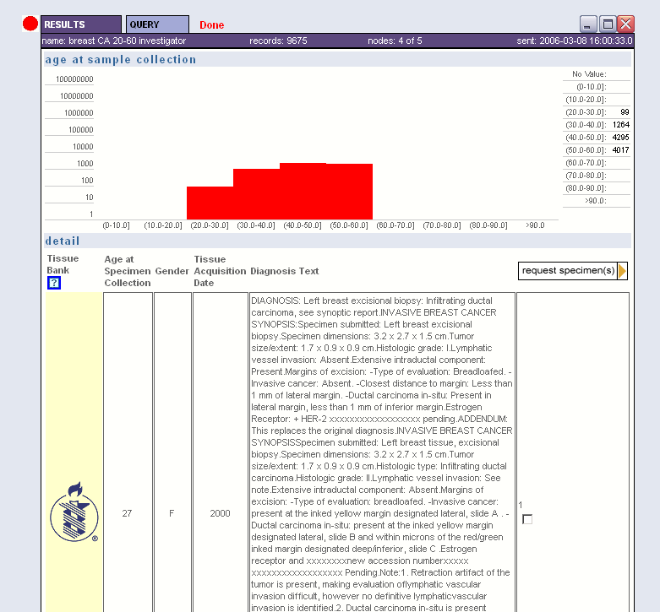

Slide 57
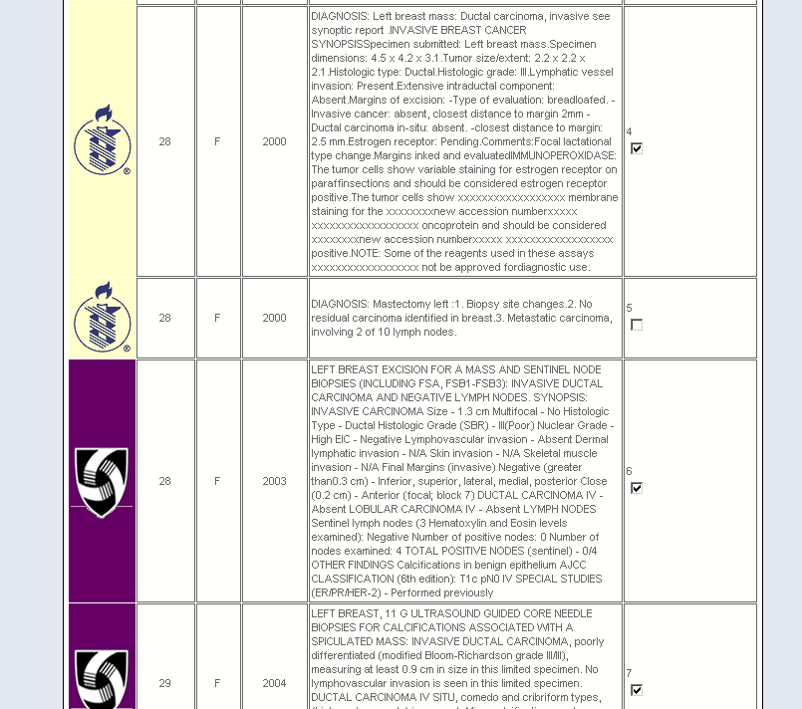

Slide 59
Ongoing Research
VSL
  Identify hundreds of specimens for creating Tissue Micro Arrays for multiple organs
  Locating cases for evaluating markers of neurotropism in melanoma
SPIN
  Network wide demonstration study of EGFR gene mutations in lung cancer
  Tissue retrieval studies
  Esoteric case finding
Notes:
EGFR – up to 100 cases per node/site, so up to 600-1000 specimens possibly.

Slide 60
SPIN Accomplishments
Designed open source peer to peer network for medical data sharing
Defined standard XML schema for representing pathology information
Created software which allows for safe use of information from pathology reports
Built a network with 7 functioning nodes
Currently have more than 2 million cases available for searching
Heterogeneous software systems sharing information
Notes:
Cheap, easy to implement
Can be used for much more than pathology data
Demonstration project ends May 2006
Future funding is unknown at this point
Even if not specifically refunded, the tools will be utilized in CaBIG project
Cancer BioInformatics Grid (CaBIG)
NCI funded effort to develop multiple reusable tools that can interoperate over a network
Comprehensive project with vast scope
SPIN/VSL tools and technology are being used as a starting point for parts of CaBIG

Slide 61
VSL Accomplishments
Built functioning network which shares tissue information among different institutions
Gained cooperation of all HMS pathology departments
Obtained IRB and institutional buy-in
Working with other tissue banks to join

Slide 62
Acknowledgements
VSL Core Directors
  Isaac Kohane (CH)
  Chris Fletcher (BWH)
VSL Team
  Connie Gee (DF)
  Frank Kuo (BWH)
  Ulysses Balis (MGH)
  Antonio Perez-Atayde (CH)
  Andrew McMurry (CH)
  Raji Mahaadevan (HMS)
  Elizabeth Sands (MGH)
SPIN
  MGH Lab of Computer Science
    Henry Chueh,
    Roger Berkowitz,
    Ana Holzbach
  Indiana
    Clem McDonald
    Gunther Schadow
  Univ. of Pittsburgh
    Michael Becich
    Rebecca Crowley
  UCLA
    Jonathan Braun
    Tom Drake
  And Many Others!
Notes:
There are too many people who have helped to be able to list them all here

Slide 63
Websites
Harvard Virtual Specimen Locator
  https://querytool.med.harvard.edu
Shared Pathology Informatics Network
  http://spin.nci.nih.gov

Slide 64
Questions?

